Slide 1
UNIT- 4 TRANSFORMER

Slide 2


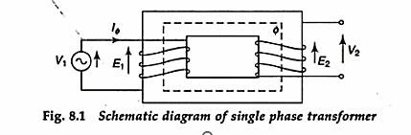
TRANSFORMER

Slide 3
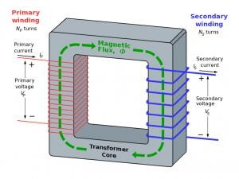
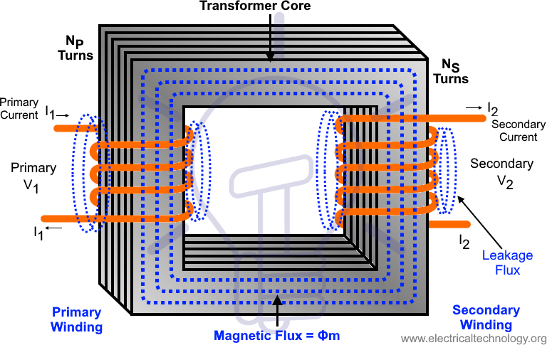
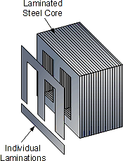

Slide 4
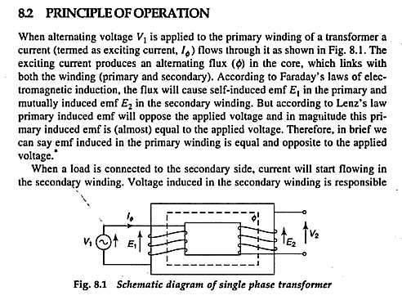

Slide 5
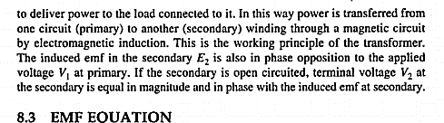
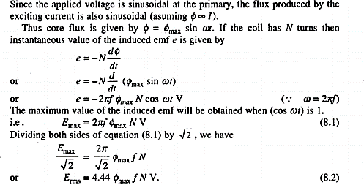

Slide 6
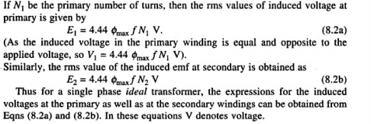

Slide 7
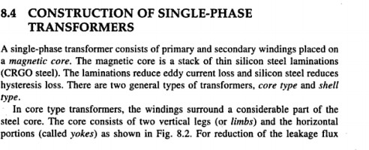

Slide 8
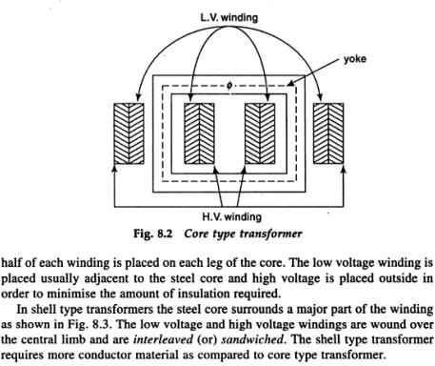

Slide 9
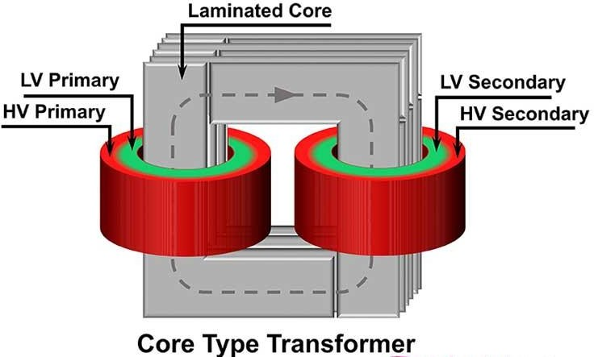

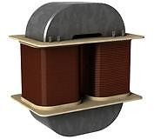

Slide 10
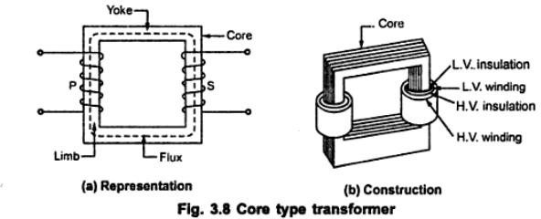

Slide 11
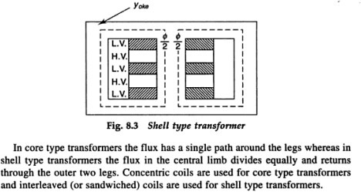

Slide 12
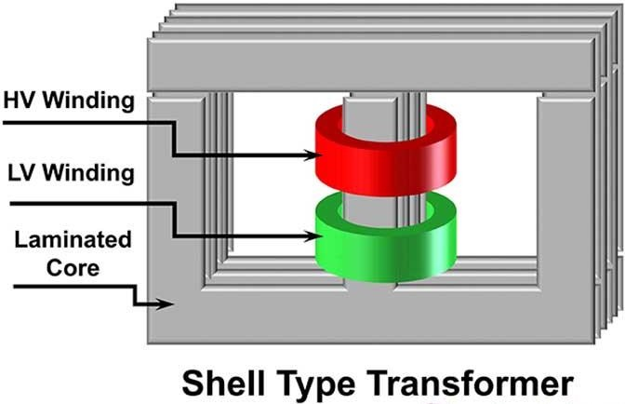
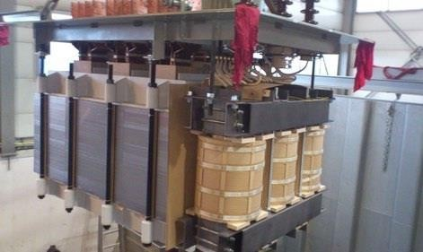

Slide 13
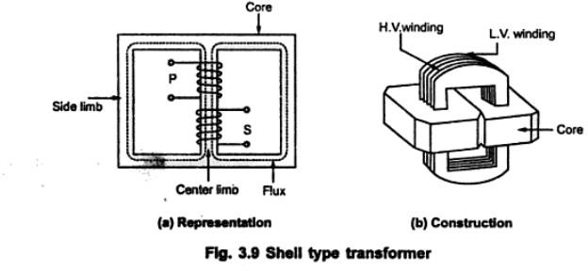

Slide 14
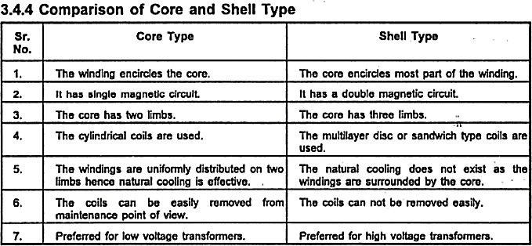

Slide 15
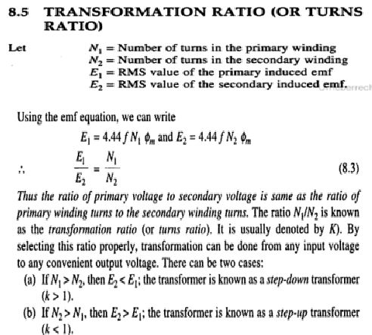

Slide 16
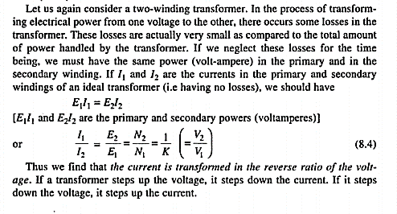

Slide 17
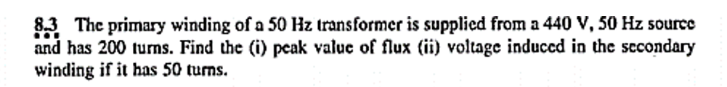

Slide 18
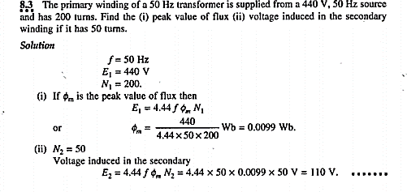

Slide 19
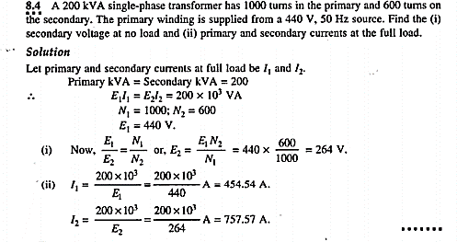

Slide 20
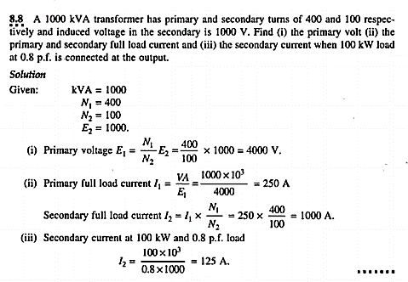

Slide 21
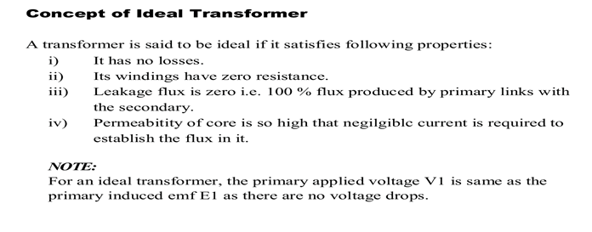

Slide 22
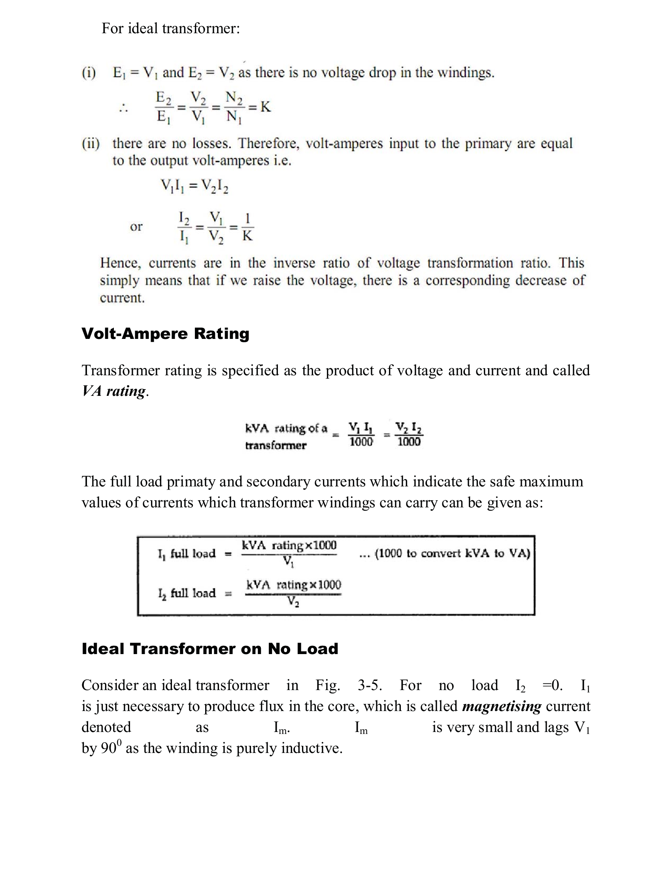

Slide 23
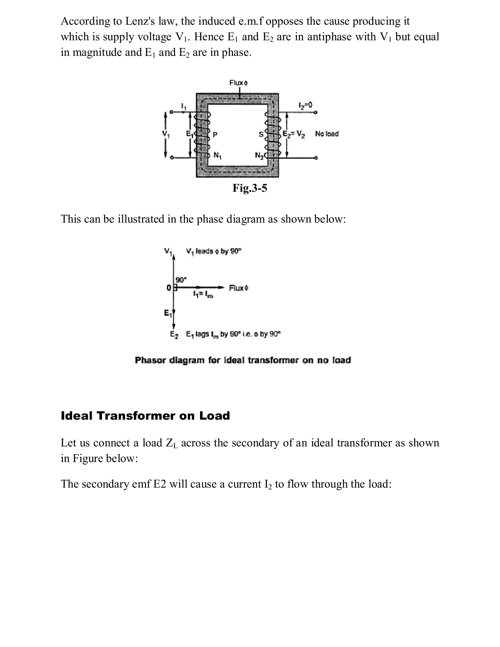

Slide 24
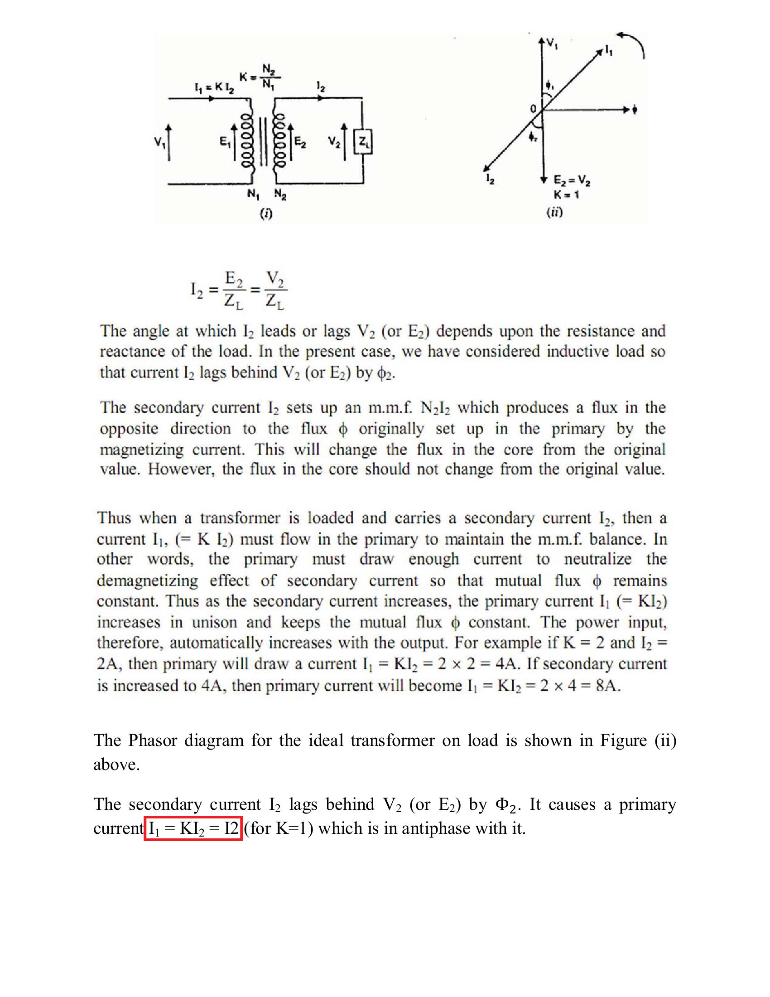

Slide 25
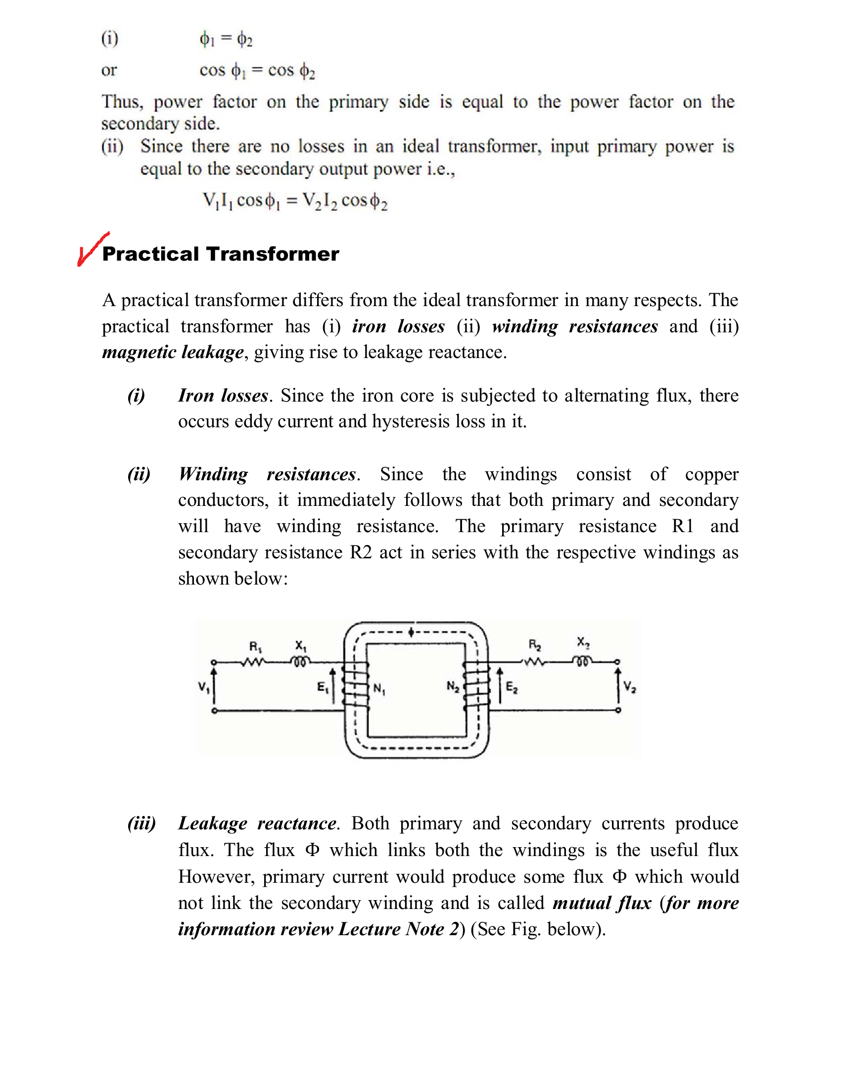

Slide 26
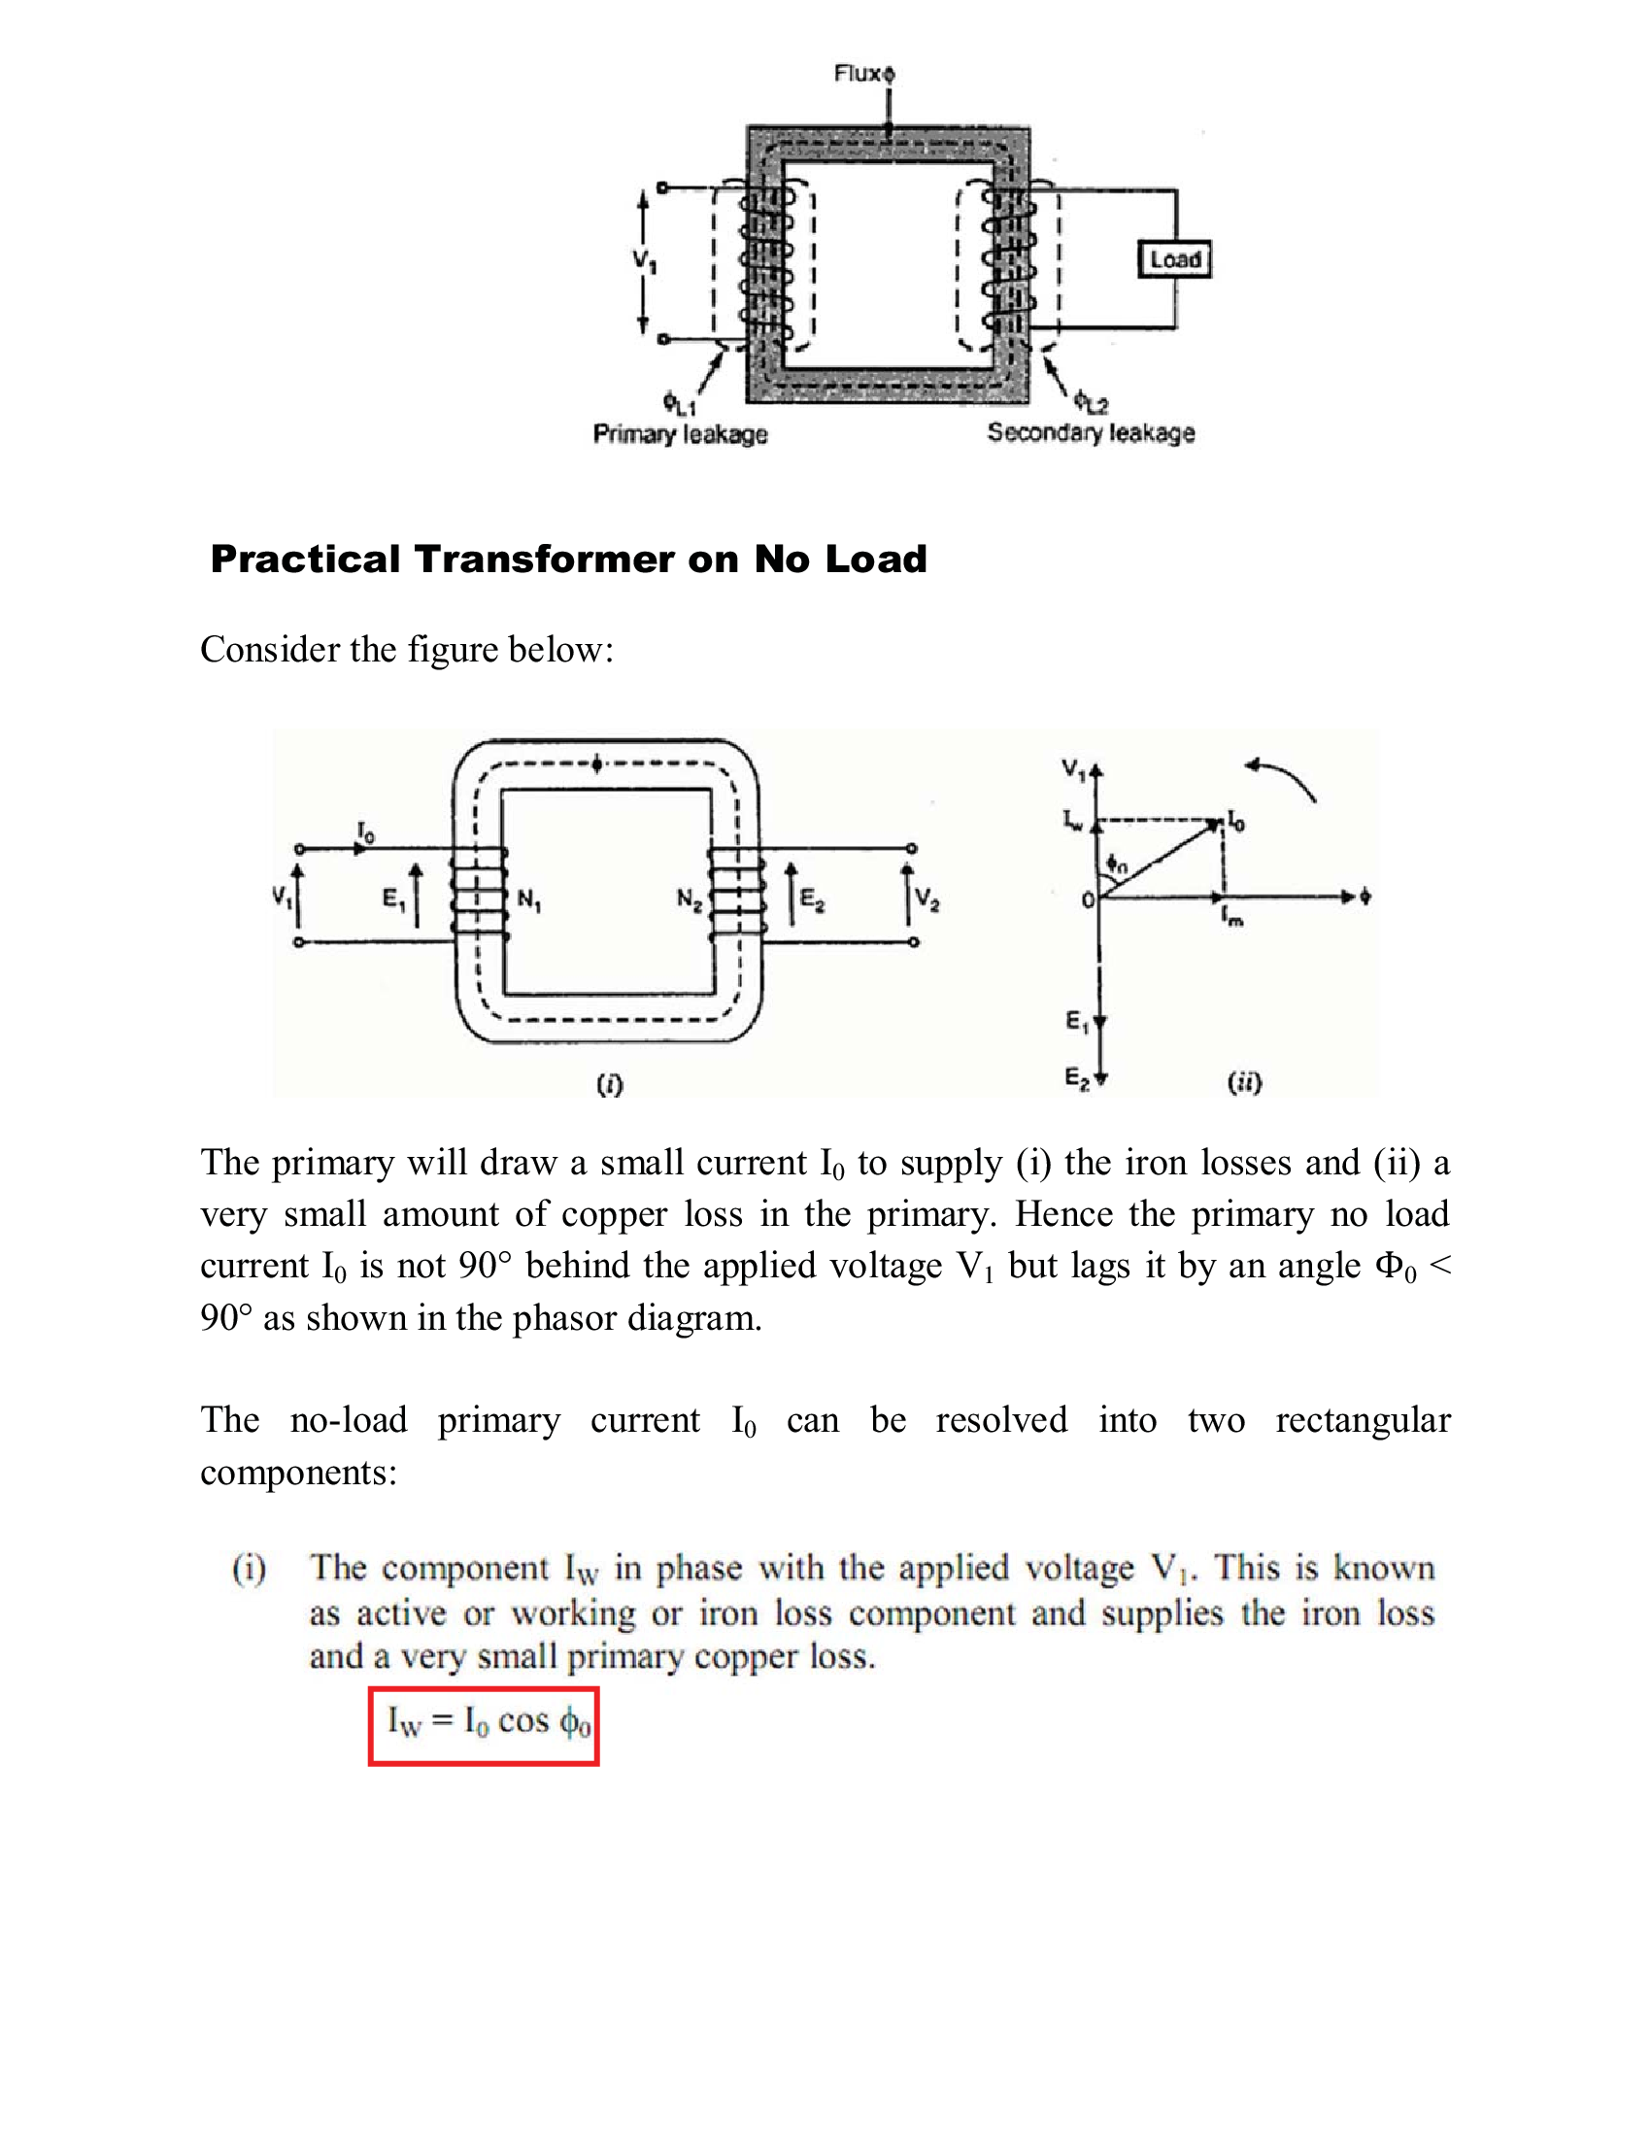

Slide 27
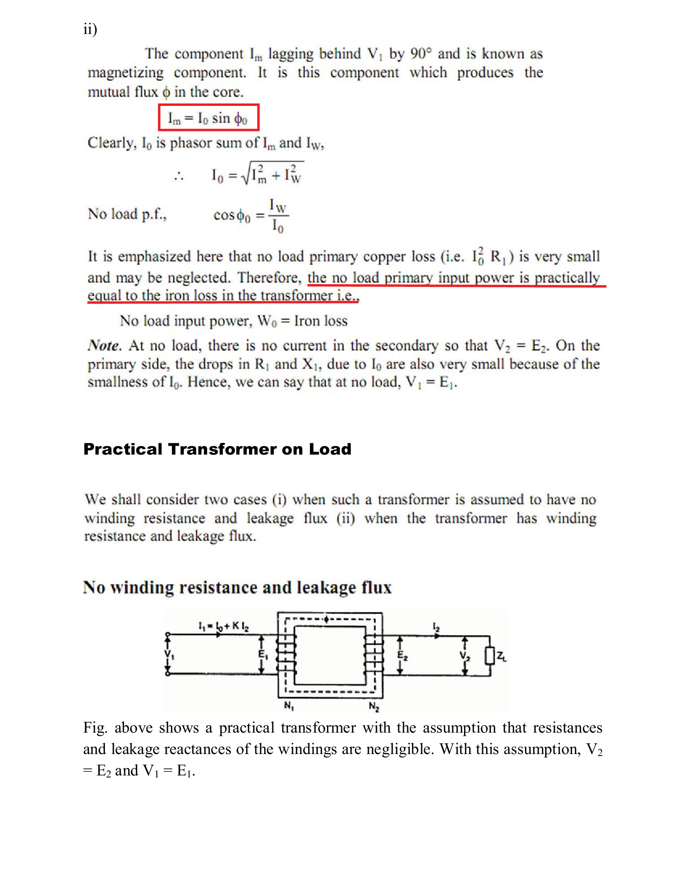

Slide 28
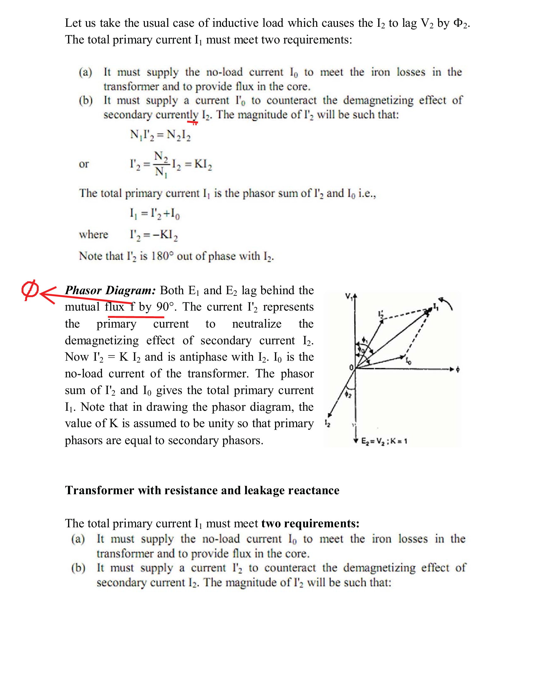

Slide 29
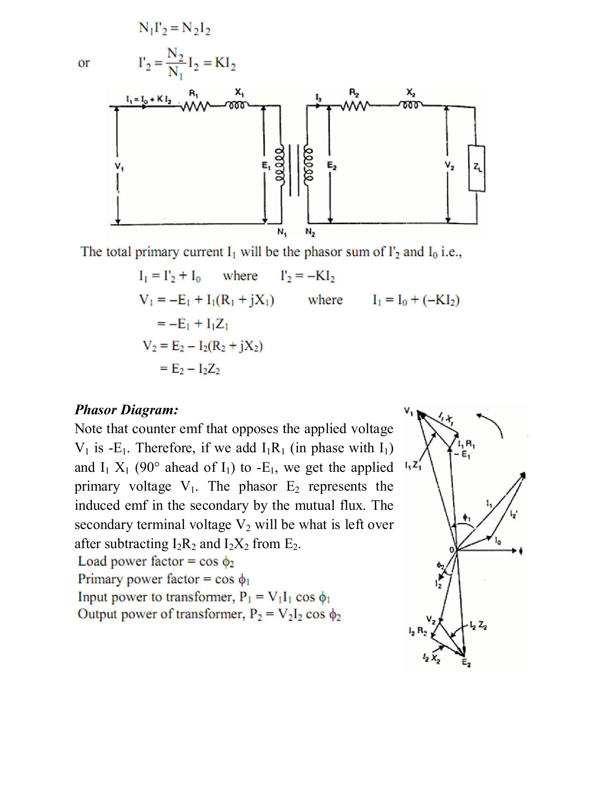

Slide 30
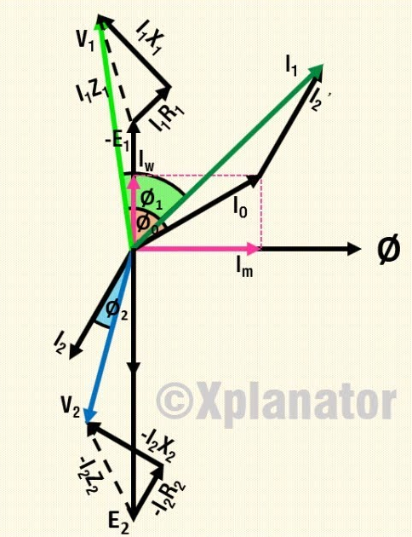

Slide 31
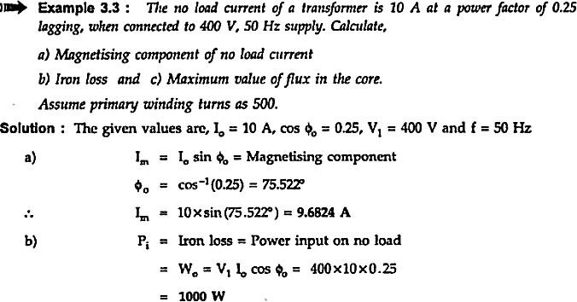
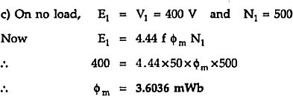

Slide 32
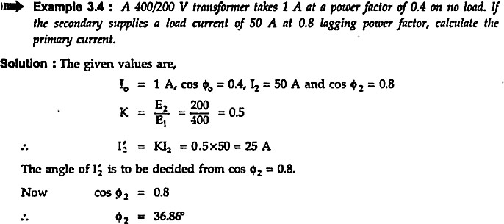

Slide 33
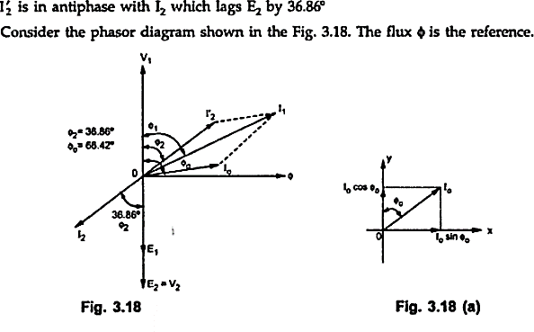

Slide 34
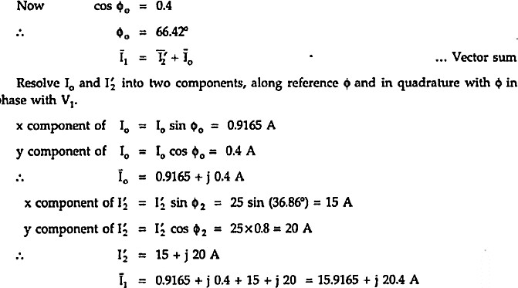

Slide 35
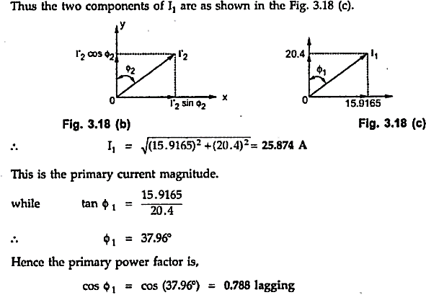

Slide 36
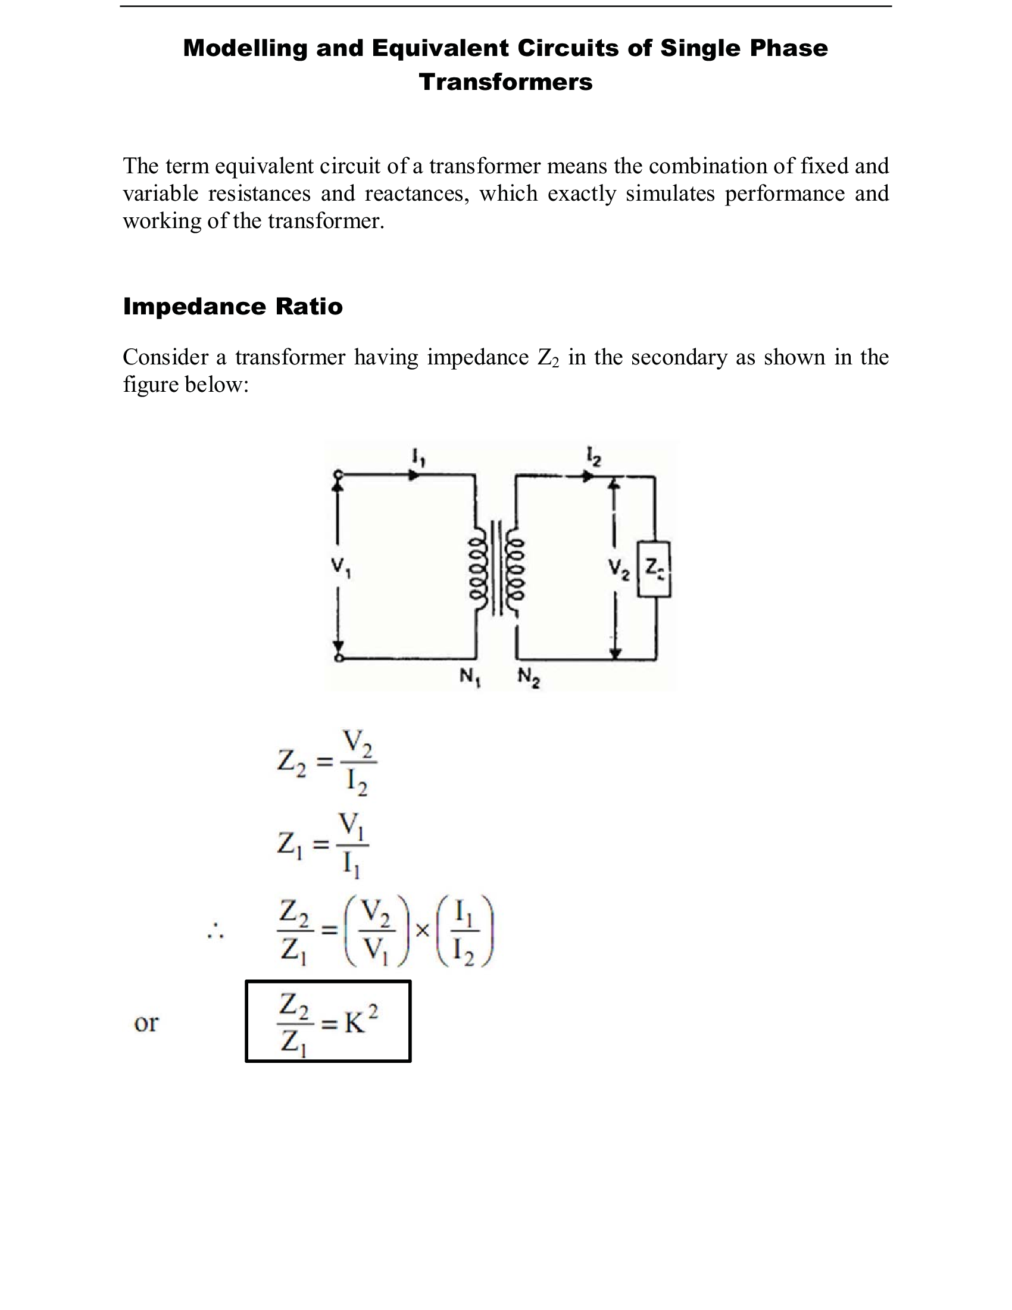

Slide 37
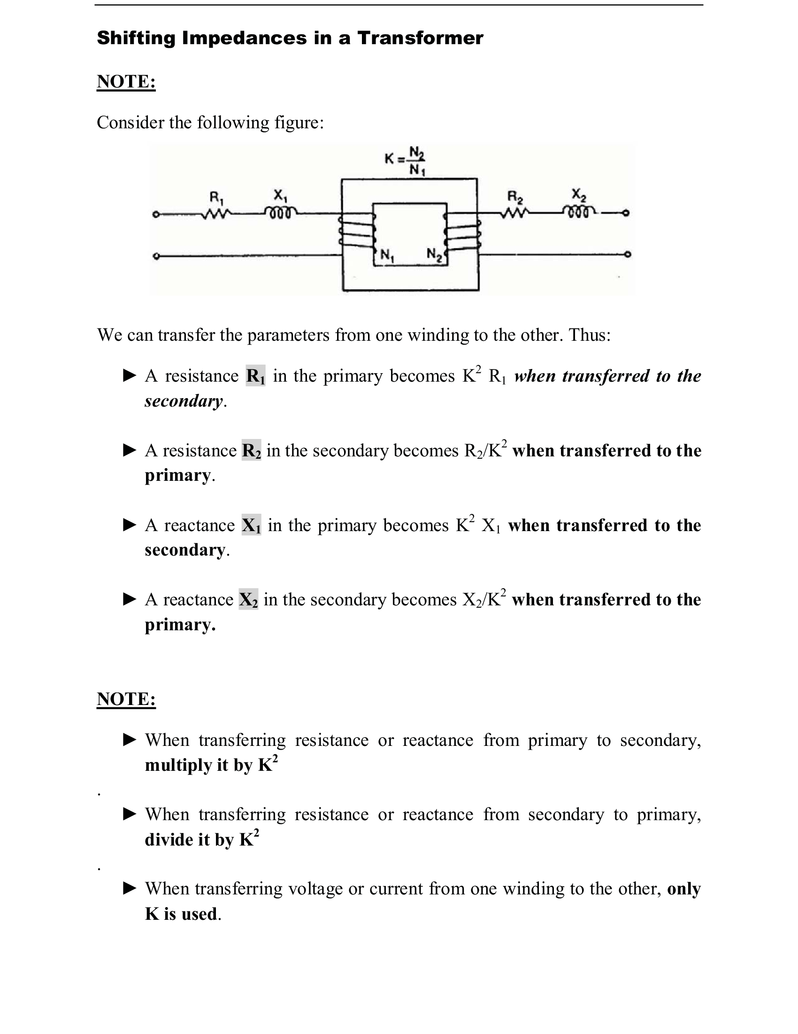

Slide 38
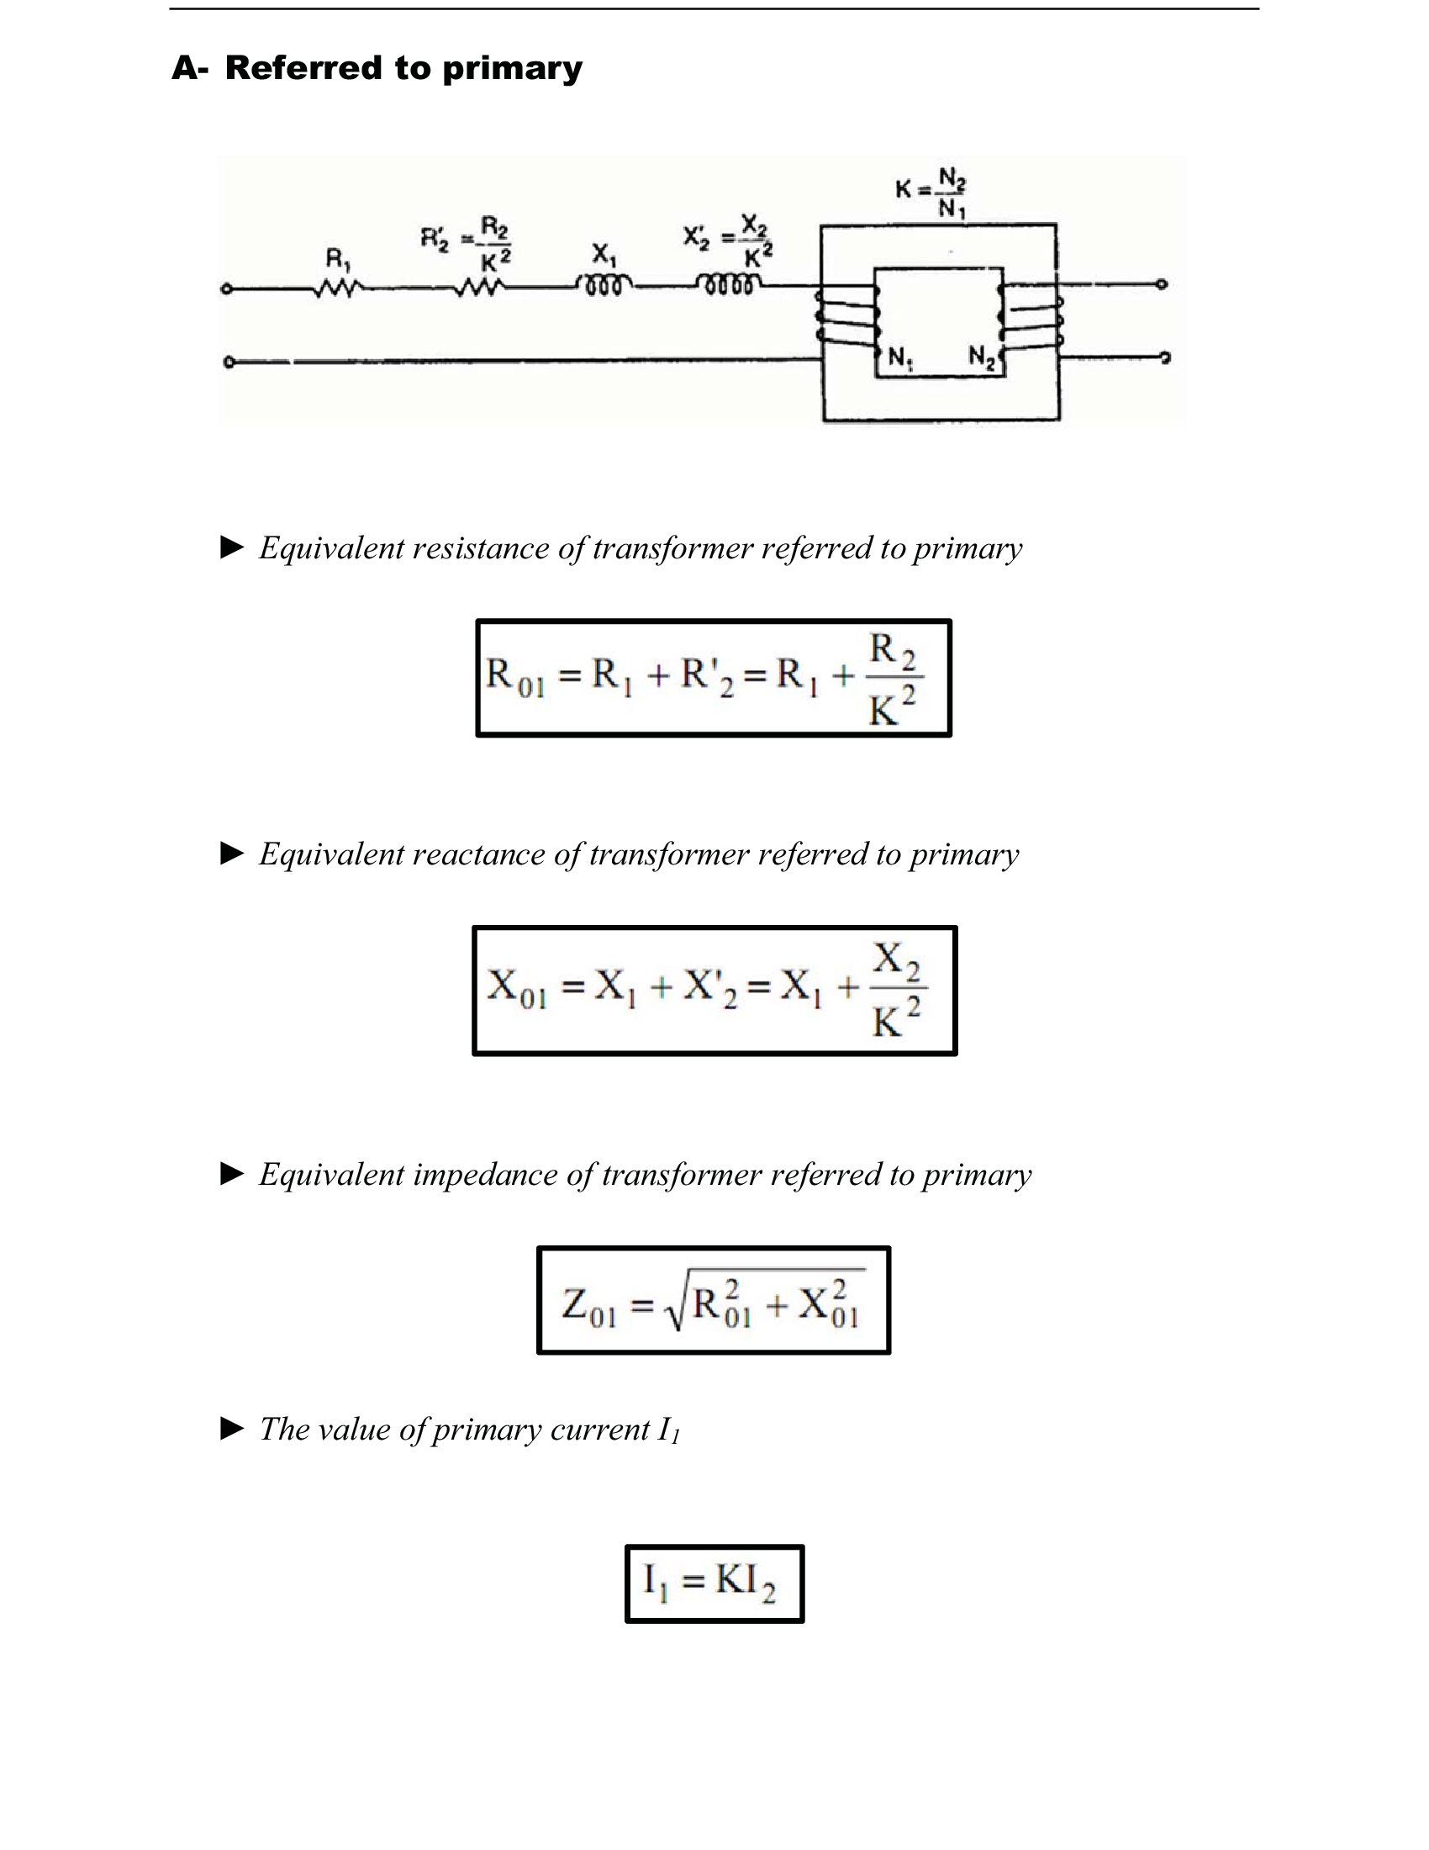

Slide 39
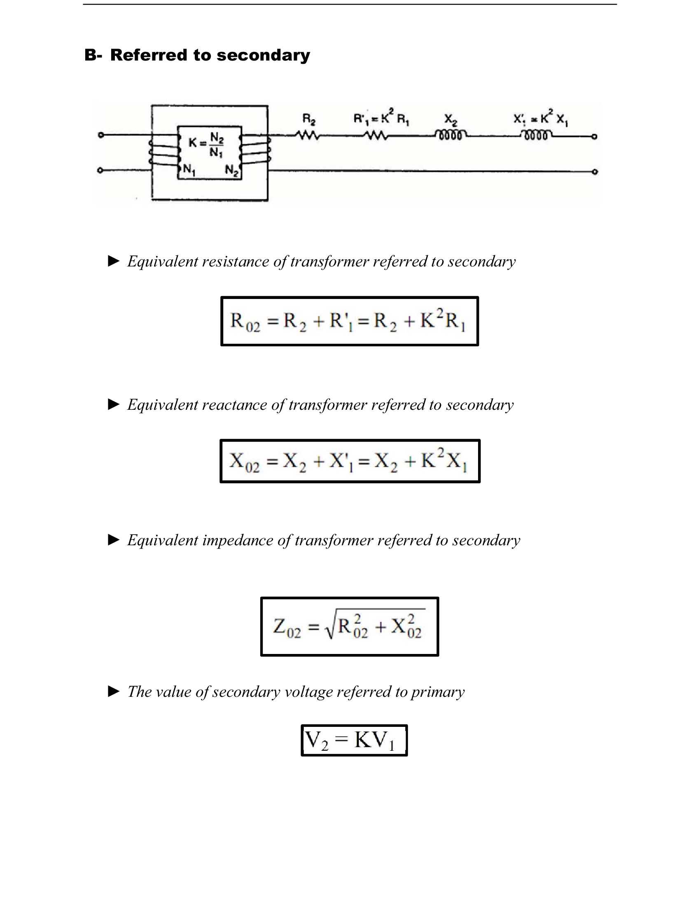

Slide 40
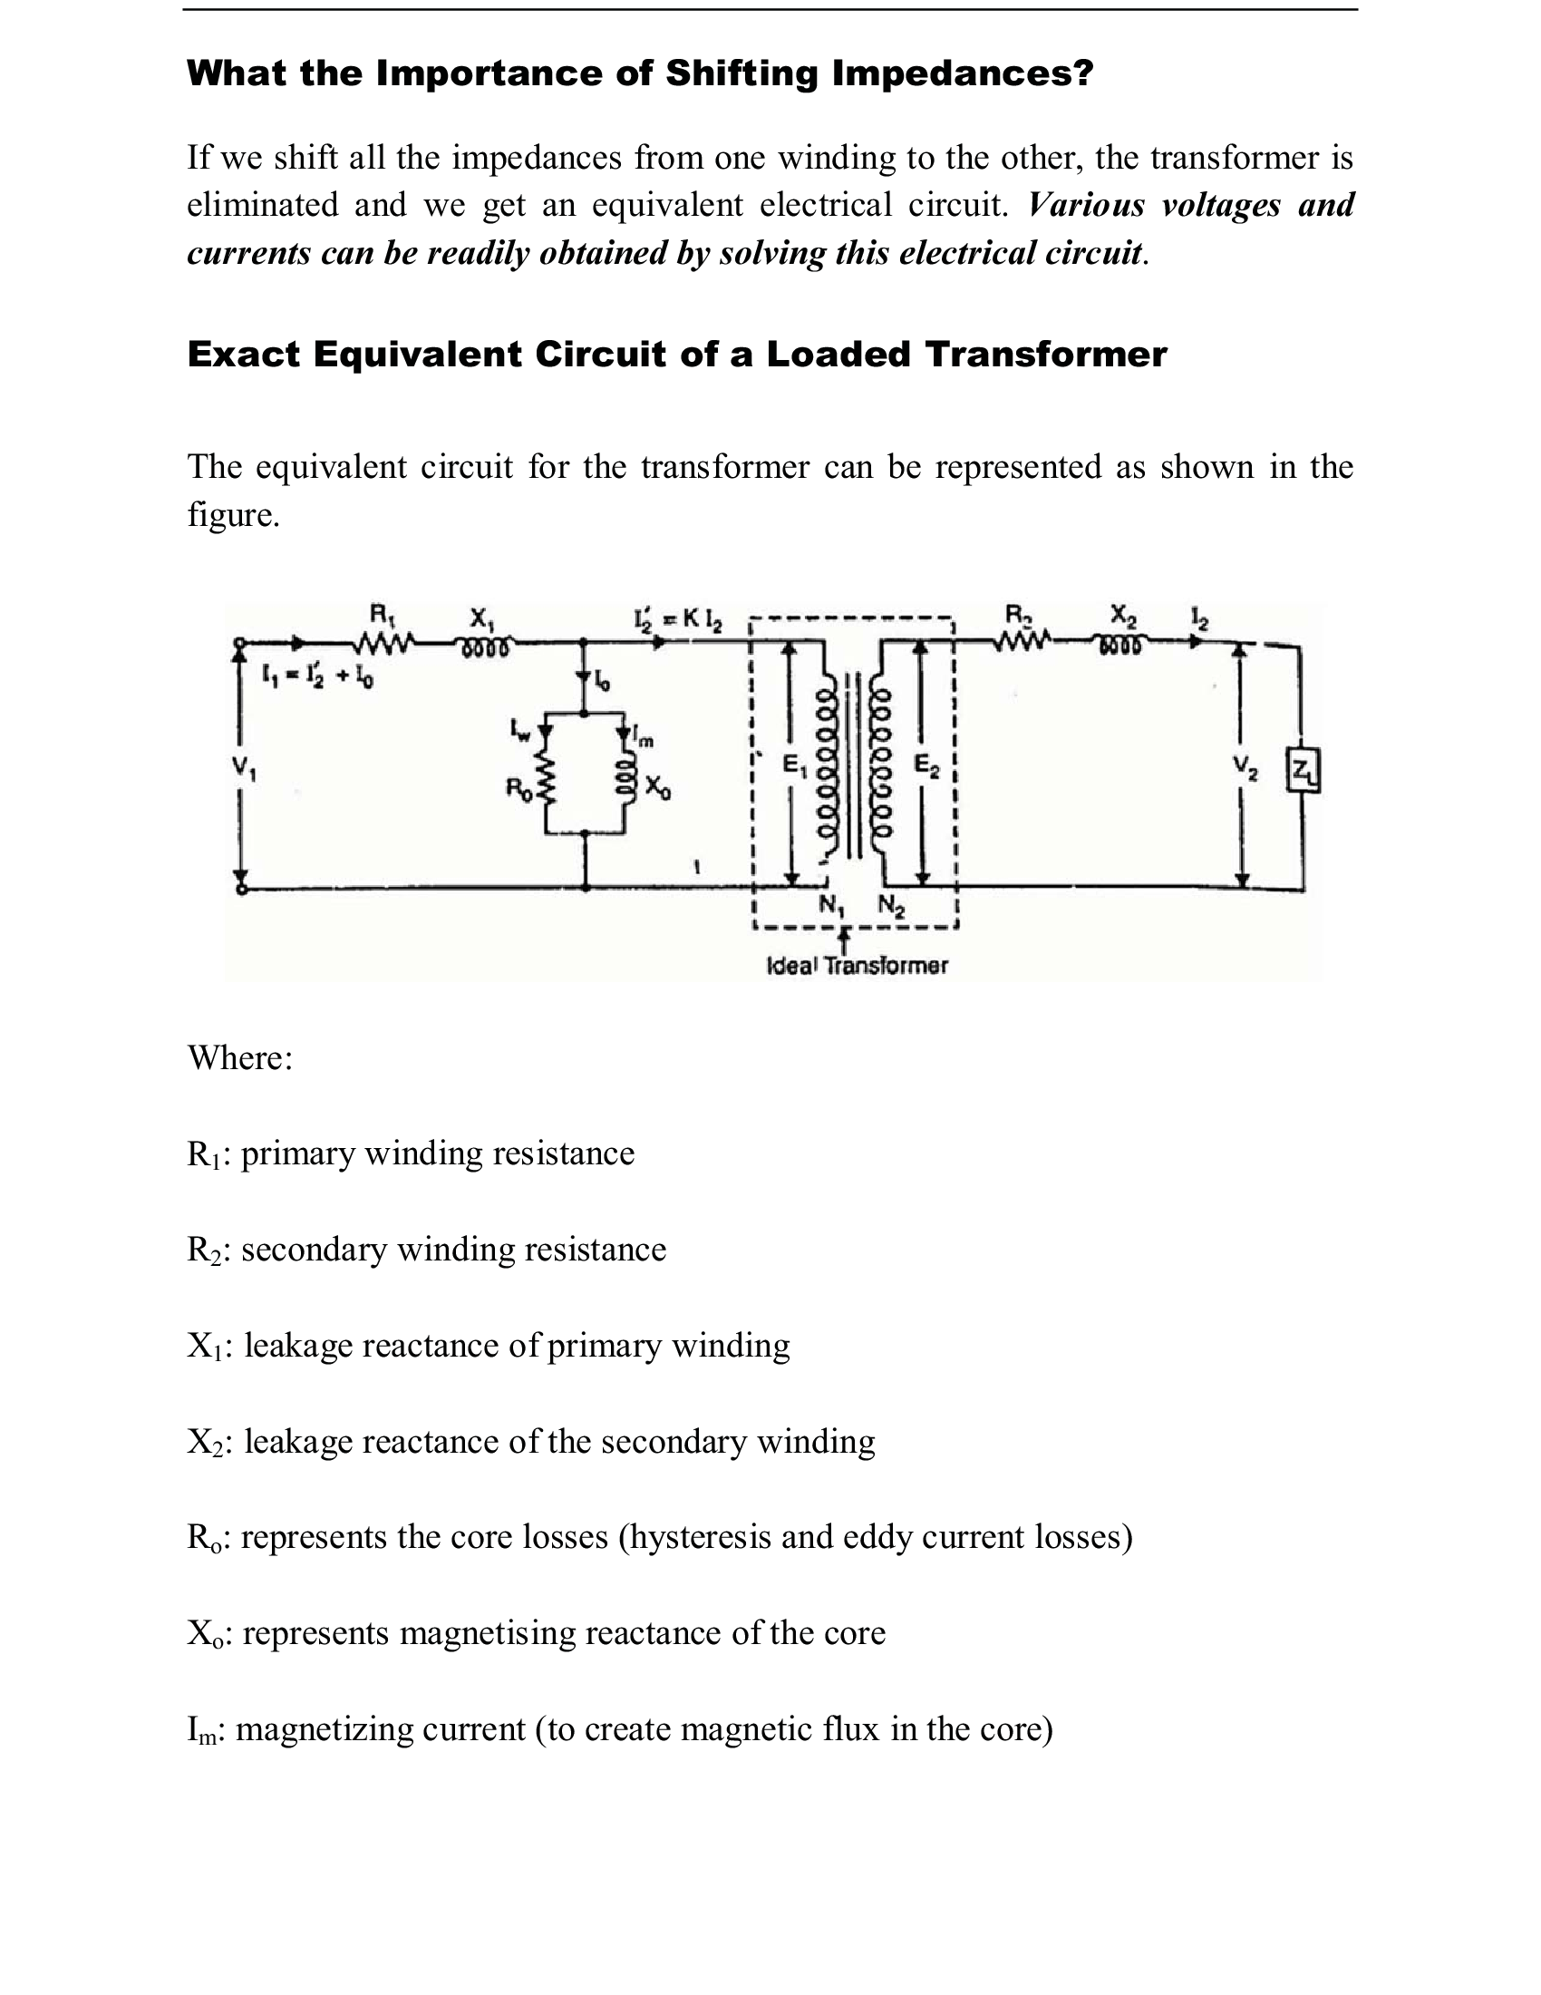

Slide 41
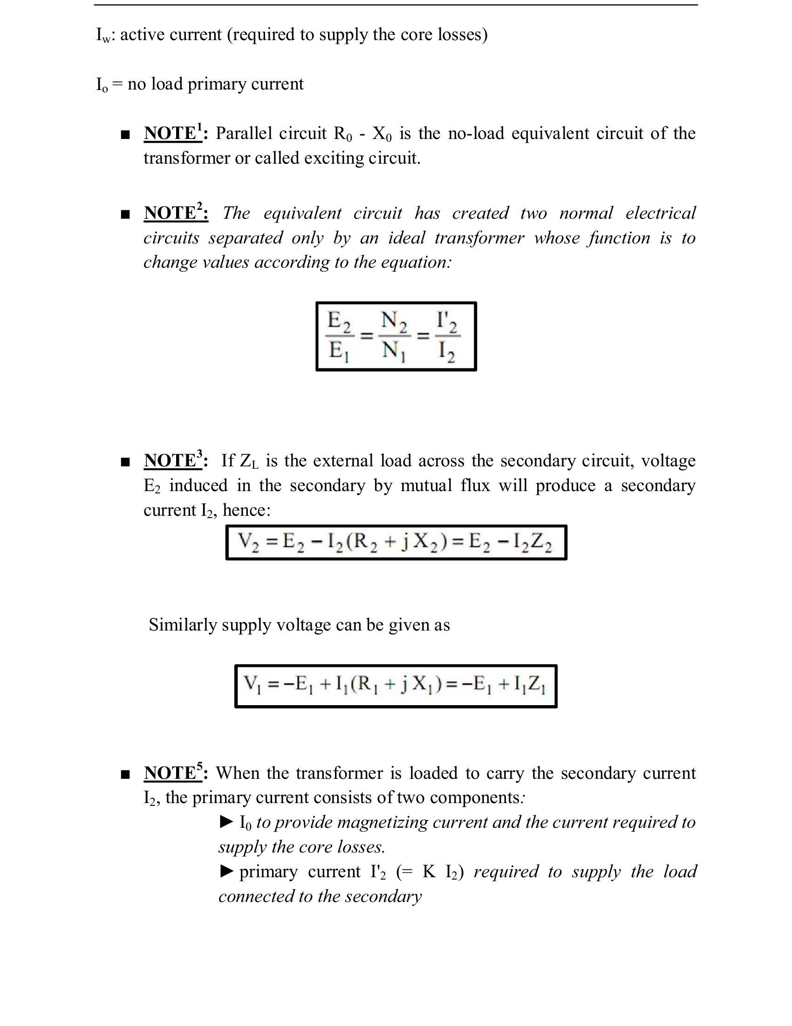

Slide 42
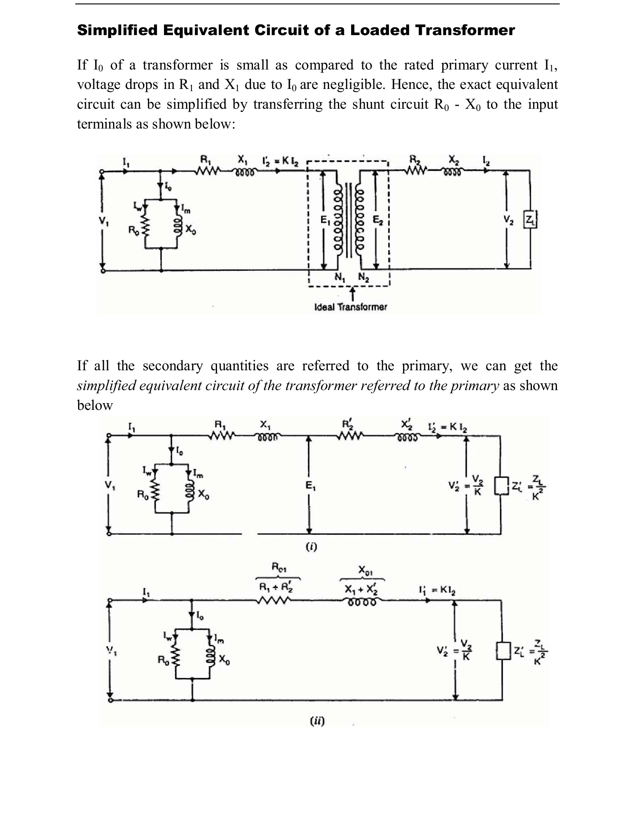

Slide 43
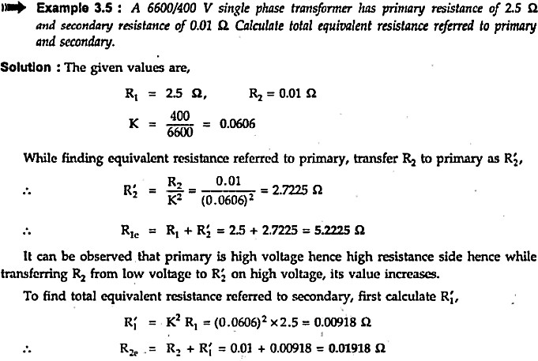

Slide 44
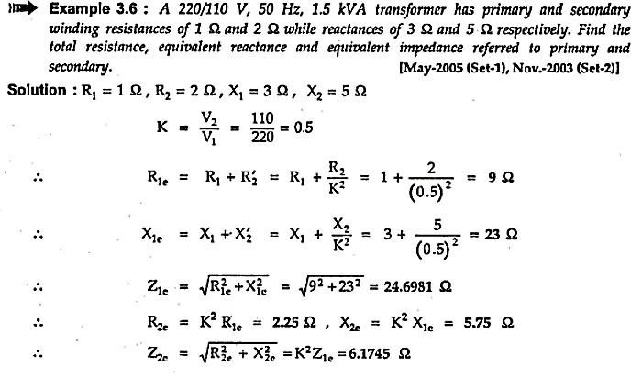

Slide 45
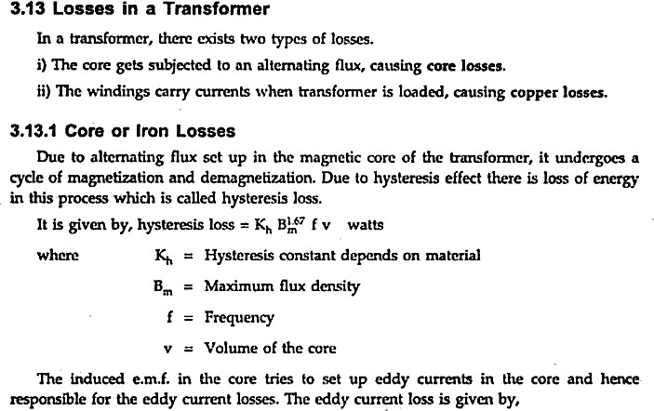

Slide 46


Slide 47


Slide 48


Slide 49



Slide 50


Slide 51



Slide 52


Slide 53


Slide 54


Slide 55


Slide 56


Slide 57


Slide 58


Slide 59


Slide 60


Slide 61


Slide 62


Slide 63


Slide 64



Slide 65


Slide 66



Slide 67


Slide 68


Slide 69


Slide 70


Slide 71
Application of Transformer
It can rise or lower the level of level of Voltage or Current
( when voltage increases, current decreases and vice-versa because P =V x I, and Power is same ) in an AC Circuit.
It can increase or decrease the value of capacitor, an inductor or resistance in an AC circuit. It can thus act as an impedance transferring device.
It can be used to prevent DC from passing from one circuit to the other.
it can isolate two circuits electrically.
85

Slide 72

Three Phase Transformer

Slide 73


Slide 74


Slide 75


Slide 76

Numerical: Three Phase Transformer

Slide 77


Slide 78


Slide 79



Slide 80


Slide 81


Slide 82


Slide 83


Slide 84
Measuring Instruments
Current, voltage, power, etc. Not visible to eyes &
must be measured using meters.
Classification 1
Absolute: Quantity is measured in terms of instrument constant and deflection
Secondary: Calibrated using Absolute instrument. Give
measurement directly.
Indicating: magnitude indicated directly
Recording: continuous record of variations of magnitude over a definite period of time
Integrating: total amount of electrical energy supplied over time
Classification 2
DC: measure only DC quantities
AC: measure only AC quantities
AC/DC: measure both AC as well as DC quantities
Classification 1
Absolute
Secondary
Indicating
Recording
Integrating
Classification 2
AC
DC
AC/DC
8

Slide 85
Measuring Instruments: Types of Torques
 Deflecting Torque: moves pointer from its
Damping Torque
zero position during measurement
Controlling Torque
Opposes deflecting torque
Limits pointer movement to ensure correct
measurement
Returns pointer to 0 under absence of deflecting torque
Controlling torque provided by
Spring Control
 As pointer moves, Phosphor bronze hair spring gets twisting.This twist produces controlling torque
prevents oscillation of pointer about final deflecting
Brings pointer to rest
position
Damping torque provided by
Air-friction damping
Piston (connected to pointer) moves in fixed air chamber, building pressure inside that opposes further piston motion
Fluid-friction damping
Light vanes/disk attached to moving system move in damping oil
Eddy-current damping
Eddy currents set up when sheet of conducting (non-magnetic) material moves in magnetic field
Eddy currents set up force to oppose this motion
Cannot be used where introduction of permanent magnet for eddy currents will distort the existing magnetic field
 Spring subjected to fatigue with time, temperature
coefficient of stiffness of spring affects measurement
Gravity Control
Small weight attached to moving system to produce controlling torque
Cheap, not subjected to fatigue, unaffected by change in temperature
Must be kept vertical, non-uniform scale
9

Slide 86


Moving Iron Instrument: Attraction type
Principle: Attraction of single piece of iron into magnetic field
Operation:
Current to be measured passed through coil, setting up magnetic field
Moving iron is magnetized and attracted to the coil, and pointer moves
Spring Control and Air-friction damping
Operating torque
Low when moving iron just enters solenoid.
Hence, Scale cramped at lower end
Increases rapidly as moving iron drawn in.
Hence, Scale expanded at upper end
∴
∴
10

Slide 87

Moving Iron Instrument: Repulsion type
Principle: Repulsion of two adjacent iron pieces magnetized by same magnetic field
Operation:
Current to be measured passed through coil, setting up magnetic field which magnetizes both irons in same direction
Repulsive force set up
Moving iron repelled by fixed iron, and
pointer moves
Spring Control and Air-friction damping
Non-uniform scale
AC and DC Measurements: deflecting
torque depends on I ²
11

Slide 88

Moving Coil Instruments: ^{Permanent Magnet}
Moving Coil (PMMC)
Principle: Current carrying conductor, placed in magnetic field, experiences torque
Operation:
Current to be measured passed through coil
Coil experiences deflecting torque due to electromagnetic effect from magnetic field of magnet
Controlling torque by 2 phosphor bronze
conducting springs
Spring Control and Eddy-current damping
✪ I and T_{c} . For steady deflection,
T_{d}
T_{c} = T_{d}
⇒θ^{∝ I}, i.e. Uniform Scale
DC measurements only
At AC, pointer follows current direction and quivers
around zero mark
12

Slide 89

Moving Coil Instruments: ^{Dynamometer-type}
Moving Coil
Principle: Current carrying conductor, placed in magnetic field, experiences torque
Operation:
Current to be measured passed through Fixed air-cored coil
Fixed Coil (divided in 2 parts) in series with Moving Coil
Coils placed parallel to each other to allow movement of Moving Coil between 2 halves of Fixed coil
Deflecting torque due to interaction of magnetic fields created by i_{f} in Fixed Coil and i_{m} Moving Coil
Spring Control and Air-friction damping

T_{d} ∝ i_{f} i_{m}
and T_{c} ∝θ. For steady deflection, T_{c} = T_{d}
⇒θ∝ i i ⇒θ∝ i², i.e. Non-uniform Scale
f m
 AC/DC measurements

Slide 90
Extension of Range
Increasing instrument range for measuring large currents, voltages or power
Commonly used: Ammeter Shunts &Voltage Multipliers
Ammeter Shunt
A low resistance in parallel with coil circuit of instrument
Greater part of circuit current passes through shunt
Shunt has 2 types of terminals, viz. Current and Potential
Voltmeter Multiplier
A high non-inductive resistance (Manganin) in series with instrument coil
Allows measurement of high voltage

Slide 91







Ammeter Shunt
Terminology
R_{m} : Internal resistance of coil, ^{R}sh : Shunt resistance
I_{m} : Full-scale deflection current, I_{sh} : Shunt current
Voltages across shunt and coil are equal, i.e.
⇒
This gives,
⇒
, where
is the multiplying factor, and

Slide 92

Voltmeter Multiplier
Terminology
R_{v} :Voltmeter resistance, R : Series resistance
I_{m} : Full-scale deflection current
 We have, V = I_{m} R_{v}
I_{m} R
⇒
is the required series resistance
R = ^{V} − R
I•_{m}
v

Slide 93

Dynamometer-type Wattmeter
Wattmeter: Combination of ammeter (Current Coil) & voltmeter (Pressure Coil)
Current Coil is Fixed Coil (divided into 2 parts) & carries current to be measured
Pressure coil is Moving Coil, in parallel with supply, carries current proportional to supply voltage
Operation:
Deflecting torque due to interaction of magnetic fields created by currents in Fixed and Moving Coils
Pointer (Moving Coil) turns about its axis
∝ 1
2π
 T ∝ i i ∝ iv R ⇒ T ∝ iv ⇒ T
2π ∫
V sinθ I sin(θ−φ) dθ
d f m
V I
inst av
max
max
⇒ T ∝ ^{max max} cosφ∝ VI cosφ
0
d
2 2
 Uniform Scale

